Slide 1
USE OF STATISTICS TO DECIDE GENUINENESS OF SALE/RENTAL INSTANCES AVAILABLE WITh VALUERS
Practicing valuers association (india)
COMPILED BY
eR. AVINASH D. KULKARNI
CHARTERED ENGINEER, GOVT REGD VALUER AND IBBI Regd Valuer
SATURDAY 19/06/2021

Slide 2
DEFINITION OF STATISTICS
Statistics is the discipline that concerns the collection, organization, Analysis, Interpretation and presentation of data
Statistics indicates consistency of data
A strong understanding of commonly used statistical methods is useful for valuation professionals creating, defending, or critiquing valuation reports

Slide 3
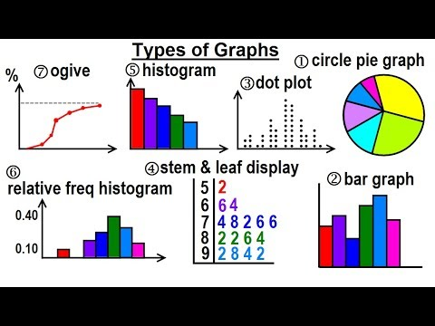
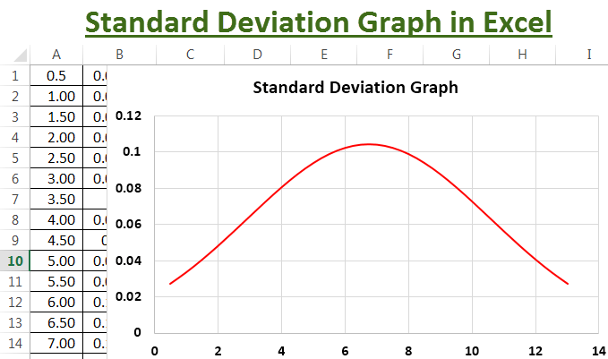
STATISTICAL GRAPHS

Slide 4
INTRODUCTION & NECESSITY
Importance of Statistics
Meaning of Genuineness
Meaning of Sale Instance
Meaning of Rental Instance
Avoid ad hoc assumptions in Valuation Report
IVS 202 – Investigation & Compliance
IVS 104 – Basis of Value

Slide 5
STATISTICS IN VALUATION
Objectives – Convert raw data into useful information
Meaning & Use of Statistics
Date – Number of Observations
Sources of Data – Primary, Secondary
Use of Data
Meaningful pattern in Data
Raw Data – Data Array
Frequency Distribution
Relative Frequency Distribution

Slide 6
GENUINENESS
the quality of truly being what something is said to be; authenticity.
the quality of being honest and sincere
the quality of being real and exactly what it appears to be
undisputed credibility
When you are being your true self, you display a genuine sense of honesty and trustworthiness

Slide 7
SALE / RENTAL INSTANCE
The act or an instance of selling/Renting ; exchange of property of any kind, or of services, for an agreed sum of money or other valuable consideration
Navanath & Ors vs State Of Maharashtra on 15 April, 2009 - IN THE SUPREME COURT OF INDIA
both the parties agree that the comparable sales instances method of valuation as adopted by the Reference Court has been rightly adopted.

Slide 8
AVOID AD HOK ASSUMPTIONS IN VALUATION
it generally signifies a solution designed for a specific problem or task, non-generalizable, and not intended to be adapted to other purposes
Avoid ad hok assumptions in Valuation Report

Slide 9
IVS 102 – INVESTIGATION & COMPLIANCE
Sufficient evidence shall be assembled by means such as inspection, inquiry, computation and analysis to ensure that the valuation is properly supported
First Hand Information – duly verified
Secondary Sources – Technical Journals
Valuation Report should stand to judicial inquiry
If no input – Avoid Valuation Assignment

Slide 10
IVS 104 – BASES OF VALUE
Compliance with this mandatory standard requires a valuer to select the appropriate basis (or bases) of value and follow all applicable requirements associated with that basis of value whether those requirements are included as part of this chapter (for IVS-defined bases of value) or not (for non IVS-defined bases of value)
Such bases have to be interpreted and applied accordingly

Slide 11
IVS 104 – BASES OF VALUE
Depending on the basis of value, the assumed transaction could take a number of forms:
(a) a hypothetical transaction,
(b) an actual transaction,
(c) a purchase (or entry) transaction,
(d) a sale (or exit) transaction, and/or
(e) a transaction in a particular or hypothetical market with specified characteristics

Slide 12
IVS 2017
Honesty – Valuer should strictly follow valuation procedure ie Data collection, site inspection, analysis, conclusion with reasoning
Integrity – First integrity to profession and thereafter to client
Being Self Conscious – Valuer should undertake and complete assignments in accordance with his own conscious and act accordingly

Slide 13
STATISTICS FOR SALE/RENTAL INSTANCE
Observation
Average of Observation
Deviation
Square of Deviation
Sum of square of deviation
Variance
Standard Deviation
Percentage Deviation
Remarks from Valuers

Slide 14
OBSERVATION
An observation in statistics is a value of something of interest you're measuring or counting during a study or experiment
An observation is a case of the data being collected
A variable is an attribute or characteristc of the observation we record in our data
All Sale/Rental instances in ascending order datewise

Slide 15
STEPS INVOLVED IN VALUATION
Site Visit
Collect sale instance data in nearby area
Study of transaction value
Work out Genuine Sale instance
Compare properties involved in Sale Instances with various parameters
Finally estimate the Value

Slide 16
PROPERTY MARKET CHARACTERESTICS
Heterogeneity & Lack of Standardization
No two properties are identical
Total land Supply is Fixed
Inelastic Supply
Effect of various Legislations
Imperfect Competition in Market

Slide 17
DATA & COLLECTION
Study Area Map from TP Office
Index II
Sale & Rental Instances
Total Permissions in Study Period
Short listing of Collected Sale Instances
Statement & Graph of Data Collected
Collection of Micro Economic data

Slide 18
SOURCES OF DATA
Sources of Data
Sub Registrar’s Office
Local enquiry – owner, agent etc
News Paper Advertisements
Land Acquisition Cases Data
Auction Sale by Income Tax, Bank etc
Valuers Data Bank

Slide 19
SITE INSPECTION
Site Visit for Shortlisted properties
Specifications & Related information collection – Noted down
Interviews are carried out
Ascertain Transaction Price & Actual price Paid
Preferences of Location, Amenities & Facilities
Data Collections form Tenants

Slide 20
ADOPTION OF WEIGHTAGES
Ad hoc weightages are assigned to various factors of comparison & % additions or deductions are done
Secured Property Access
Weightage Score System is used to make the comparison as objective as possible
P = f (STLA)
Size, Time, Location & Age

Slide 21
WEIGHTAGE SCORE
Identify Factors of Comparisons & their levels
Assign Appropriate weightages & Levels
Prepare Weightage Criteria Table
Work our Weightages of each of Property
Compare the Property on the basis of Total Weightage Score
Area factor is More Important

Slide 22
ASPECTS OF COMPARISON FACTORS
Physical – Situation, Location, Engineering & Building
Legal – Ownership, Tenure, Easement, TPS Act
Social – Communication, Civic Amenities, Stigma
Economical – Employment & Wage Level, Demand & Supply, Credit Facility, Money Market Condition, Rental Yield, Taxation

Slide 23
RENTAL INSTANCES
Transaction Date
Builtup Area
Rent
Deposit
TWS
Virtual Rent
Rent/Sqm/Month Calculation

Slide 24
SALE INSTANCES
Transaction Date
Price paid
Builtup Area
TWS
Estimation of Fair Market rent
Annual Rent, Outgoings, Net Rent
YP Calculation
Rate of Interest Calculation

Slide 25
DEVIATION
Deviation that is a difference between an observed value and the true value of a quantity of interest
The standard deviation formula may look confusing, but it will make sense after we break it down. ...
Step 1: Find the mean.
Step 2: For each data point, find the square of its distance to the mean.
Step 3: Sum the values from Step 2.
Step 4: Divide by the number of data points.
Step 5: Take the square root.

Slide 26
VARIANCE
In probability theory and statistics, variance is the expectation of the squared deviation of a random variable from its mean
it measures how far a set of numbers is spread out from their average value
The variance is the square of the standard deviation

Slide 27
STANDARD DEVIATION
Standard deviation is a measure of dispersement in statistics
“Dispersement” tells you how much your data is spread out
Specifically, it shows you how much your data is spread out around the mean or average
The bell curve (what statisticians call a “normal distribution“) is commonly seen in statistics as a tool to understand standard deviation

Slide 28
DISPERSION
Dispersion refers to a statistical term which depicts the size of the distribution of values expected for a specific variable
Dispersion can be estimated by several different statistics, such as range, variance, and standard deviation
The measures of dispersion are important as it helps in understanding how much a data is spread (i.e. its variation) around a central value

Slide 29
SALE/RENTAL INSTANCE DATA
Sr No | Observation | Deviation | Square | % Deviation | Remarks
1 | 2400 | -670 | 448900 | -1.67 | Under Weighted
2 | 3250 | 180 | 32400 | 0.45
3 | 3400 | 330 | 108900 | 0.82
4 | 2600 | -470 | 220900 | -1.17 | Under Weighted
5 | 3150 | 80 | 6400 | 0.20
6 | 3000 | -70 | 4900 | -0.17
7 | 3700 | 630 | 396900 | 1.57 | Over Weighted
8 | 2700 | -370 | 136900 | -0.92
9 | 3550 | 480 | 230400 | 1.20 | Over Weighted
10 | 2950 | -120 | 14400 | -0.30
 | 30700 |  | 1601000
Average | 3070 | Variance | 160100
 |  | Std Deviation | 400.12

Slide 30
CORELATION IN STATISTICS
Correlation is a statistical measure that expresses the extent to which two variables are linearly related (meaning they change together at a constant rate).
0 - 1 Direct Correlation – Rate & Rent
0 to -1 Inverse Correlation – YP & ROI

Slide 31
CORELATION IN STATISTICS
High degree: If the coefficient value lies between ± 0.50 and ± 1, then it is said to be a strong correlation.
Moderate degree: If the value lies between ± 0.30 and ± 0.49, then it is said to be a medium correlation.
Low degree: When the value lies below + . ...
No correlation: When the value is zero

Slide 32
WEIGHTED STANDARD DEVIATION
To find this type of percent deviation, subtract the known value from the mean, divide the result by the known value and multiply by 100
A weighted standard deviation allows you to apply a weight, or relative significance to each value in a set of values
Weighted standard deviations are often used for frequency data

Slide 33
STATISTICS IN DATA MANAGEMENT
Location (As per RR Chart)
Sale instance, Dast Number & Date
Property Type – Plot, Bunglow, Flat, Shop etc
RR Valuation & Market Value (Price Paid)
Market Rate (Rs/Sqm) for Plot, Flat & Shop
Mean, Mode & Median

Slide 34
STATISTICS IN DESKTOP VALUATION
Rate Research –
RR Rate
Primary - Fair Market Rate as per Index II,
Primary – Nearby locality Index II (Use STLA)
Secondary – 99 Acre, Internet inquiry, Advt
Mean, Mode, Mediation, Standard Deviation
Range of Rates (Before Site Visit)
Rate considered after Analysis

Slide 35
STATISTICS IN TWS CALCULATION
Sr No | Description | Weightage | Rating | Level 1 | Level 2 | Level 3 | Level 4 | Level 5
1 | Social Infra | 10% |  | Poor | Below | Average | Good | Best
2 | Location Micro | 10% |  | Poor | Below | Average | Good | Best
3 | Location Vista | 5% |  | Poor | Below | Average | Good | Best
4 | Age | 10% |  | Poor | Below | Average | Good | Best
5 | Specifications | 15% |  | Poor | Below | Average | Good | Best
6 | Amenities | 10% |  | Poor | Below | Average | Good | Best
7 | Demand | 10% |  | Max | Good | Moderate | Less | Very Less
8 | Supply | 10% |  | Very Less | Less | Moderate | Good | Max
9 | Furnished | 5% |  | Poor | Below | Average | Good | Best
10 | B/up | 15% |  | <200 | 151 to 200 | 101 to 150 | 51 to 100 | 50

Slide 36
HEDONIC PRICING MODEL P = f(STLA)
The hedonic pricing model is used to estimate the extent to which each factor affects the market price of the property
It is most commonly applied to variations in housing prices that reflect the value of local environmental attributes
The hedonic principle maintains that humans strive to maximize pleasant feelings and avoid unpleasant feelings

Slide 37
STATISTICS IN HEDONIC PRICING MODEL
Time | Add 0.75 to 1% per Month
Location/Situation | Add 10% or more if property is on Main Road Near to Market/Business Place | Deduct 10% or more if property is Interior Road Away from Market/Business Place
Size | Add 10% or more if Size of property is less than comparable property | Deductd 10% or more if Size of property is More than comparable property
Age | Add 10% or more if age of property is less | Deduct 10% or more if age of property is less
Percentage Factors should be decided by Analysis

Slide 38
ADJUSTMENT GRID MODEL
It uses a small number of recently sold properties in the immediate vicinity of the subject property to estimate the value of its attributes
Adjustments are calculated by multiplying an adjustment factor times the quantity difference between the subject and comparable
Based on Study of Local Market
It may be difficult to stand in Court Scrutiny
Depends on Perception & Experience of Valuer

Slide 39
STATISTICS IN ADJUSTMENT GRID MODEL
Sr No | Factors | Property | Sale 1 | Sale 2 | Sale 3 | Remarks
1 | Area | 80 | 110 | 85 | 65
2 | Rate | ? | 45000 | 44000 | 50000
3 | Time | 19/06/21 | 01/05/21 | 01/03/21 | 01/01/21
4 | Adjust Time |  | 1% | 2% | 3%
5 | Rate
6 | Location |  | -2% | Nil | -5%
7 | Size/Area |  | 8% | 6% | 4%
8 | Age |  | Nil | 20% | 5%
9 | Specifications |  | 20% | Nil | 9%
10 | Overall Adjust |  | 25% | 28% | 16%
11 | Final Adjust |  | 56250 | 56320 | 58000

Slide 40
QUALITY REGRESSION TECHNIQUE
Regression models provide an alternative that is more flexible and objective
A model can be built with numerous variables that are tested for impact on the value of a property
Flexibility
Objective Approach
Sticking to Your Core Competency

Slide 41
QUALITY REGRESSION ANALYSIS
Sr No | Factor | Property | Sale 1 | Sale 2 | Sale 3 | Remarks
1 | Area
2 | Rate/Sqm
3 | Time Factor
4 | Adjust Time
5 | Adjust Rate
6 | Weightages | LVL Factor | LVL Factor | LVL Factor | LVL Factor | LVL Factor
7 | Location
8 | Size/Area
9 | Age
10 | Specification
11 | Income/Rent

Slide 42
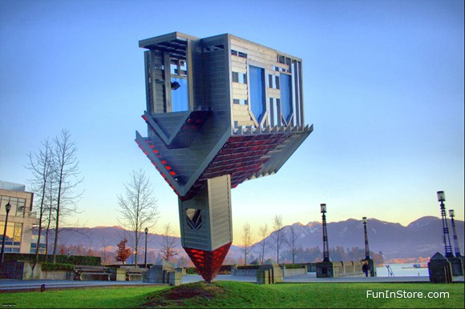
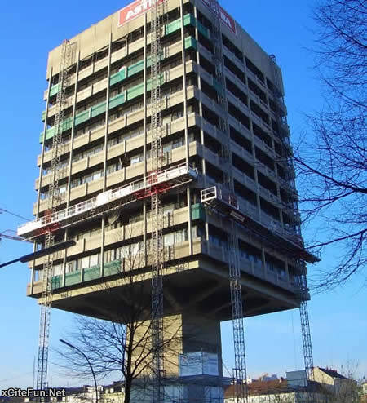
Proud of Civil Engineering

